Slide 1
Map Reduce

Slide 2
From Previous session

Slide 3
Map-Reduce
Programmer specifies:
Map and Reduce and input files
Dataflow:
Input and Output are stored on HDFS
Intermediate results are stored on local FS
Input 0
Input 1
Input 2
Map 0
Map 1
Map 2
Shuffle
Reduce 0
Reduce 1
Out 0
Out 1

Slide 4
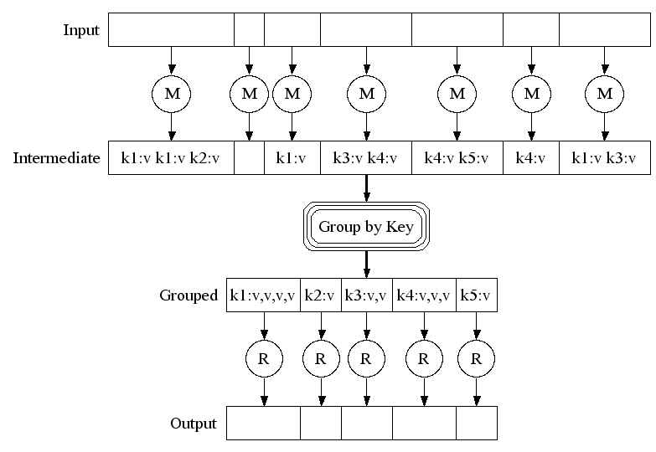
Map-Reduce: A diagram
Big document
MAP:
Read input and produces a set of key-value pairs
Group by key:
Collect all pairs with same key
(Hash merge, Shuffle, Sort, Partition)
Reduce:
Collect all values belonging to the key and output

Slide 5
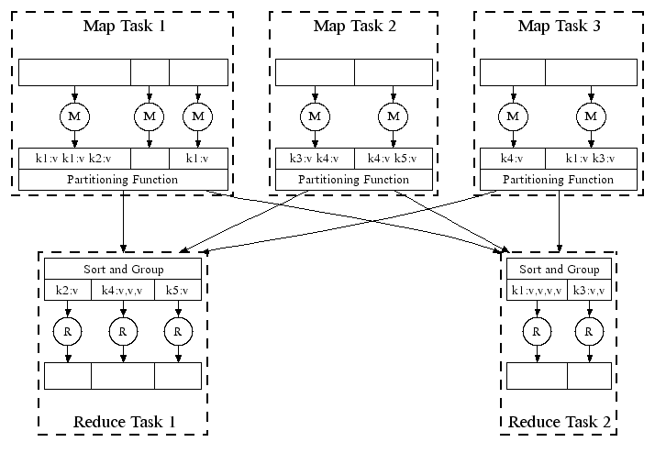
Map-Reduce: In Parallel
All phases are distributed with many tasks doing the work

Slide 6
Working of Word Count
Provided by the programmer
Provided by the programmer
MAP:
Read input and produces a set of key-value pairs
Group by key:
Collect all pairs with same key
Reduce:
Collect all values belonging to the key and output
The crew of the space shuttle Endeavor recently returned to Earth as ambassadors, harbingers of a new era of space exploration. Scientists at NASA are saying that the recent assembly of the Dextre bot is the first step in a long-term space-based man/mache partnership. '"The work we're doing now -- the robotics we're doing -- is what we're going to need ……………………..
(The, 1)
(crew, 1)
(of, 1)
(the, 1)
(space, 1)
(shuttle, 1)
(Endeavor, 1)
(recently, 1)
….
(crew, 1)
(crew, 1)
(space, 1)
(the, 1)
(the, 1)
(the, 1)
(shuttle, 1)
(recently, 1)
…
(crew, 2)
(space, 1)
(the, 3)
(shuttle, 1)
(recently, 1)
…
Sequentially read the data
Only sequential reads
Big document
(key, value)
(key, value)
(key, value)

Slide 7
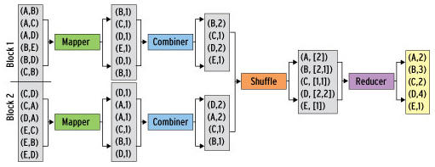
Refinement: Combiners - Example
Back to our word counting example:
Combiner combines the values of all keys of a single mapper (single machine):
Much less data needs to be copied and shuffled!

Slide 8
Map Reduce Algorithms

Slide 9
Matrix-Vector Multiplication
Suppose we have an n×n matrix M, whose element in row i and column j will be denoted m_{ij} .
Suppose we also have a vector v of length n, whose jth element is v_{j} .
Then the matrix-vector product is the vector x of length n, whose ith element x_{i} is given by
Assumption: Matrix M and vector v are stored in DFS, such that their row-column coordinates are either discoverable from file position or explicitly specified as (i, j, m_{ij}) & (j, v_{j})

Slide 10
Matrix-Vector Multiply : Case 1
Case 1: Vector v can fit in memory
Hence, vector v available to every Map task
The Map function:
Vector v is entirely read into memory of the node executing a Map task (if not already read).
Each Map task will operate on a chunk of matrix M
For each matrix element m_{ij}, Map task produces key-value pair as (i, m_{ij} * v_{j})
NOTE: All terms that will sum-up to give component of x, have same key i
The Reduce function:
It simply sums all the values associated with a given key i and generates key-value pair (i, x_{i})

Slide 11
Matrix-Vector Multiply : Case 2
Case 2: Vector v cannot fit in memory
Hence, divide the vector v into an equal sized horizontal strips. Also, divide matrix M into vertical strips, of width same as height of strips of vector v.
Division of Matrix M and vector v into five strips
Each Map task is assigned a chunk from one of the stripes of Matrix M and gets corresponding stripe of vector v.

Slide 12
Basic Relational Algebra Operations
Select:
Map function: For each t in R, test if it satisfies C. If so, produce (t,t).
Reduce function: Identity.
Project:
Map function: For each tuple t in R, construct tuple t’ by eliminating those attributes from t which are not in S. Output of Map task is key-value pair (t’, t’).
Reduce function: For each (t’, [t’, t’, t’, …]), reduce function generates (t’, t’). Thereby, it eliminates duplicates.

Slide 13
Set Operations of Relational Algebra
Union:
Map Function: Turn each input tuple t into a key-value pair (t, t).
Reduce Function: Associated with each key t there will be either one or two values. Produce output (t, t) in either case.
Intersect:
Map Function: Turn each tuple t into a key-value pair (t, t).
Reduce Function: If key t has value list [t, t], then produce (t, t). Otherwise, produce nothing.
Set Difference:
Map Function:
Reduce Function:

Slide 14
Set Operations continued…
Set Difference: Given two relations R and S, to compute set difference say (R – S).
NOTE - The Map function can pass tuples from R and S through, but must inform the Reduce function whether the tuple came from R or S.
The Map Function: For a tuple t in R, produce key-value pair (t,R), and for a tuple t in S, produce key-value pair (t, S).
Note - The intent is that the value is the name of R or S (or better, a single bit indicating whether the relation is R or S), not the entire relation.
The Reduce Function: For each key t, if the associated value list is [R], then produce (t, t). Otherwise, produce nothing.

Slide 15
Relational Algebra Operation: Natural Join
Compute the natural join R(A,B) ⋈ S(B,C)
R and S are each stored in files
Tuples are pairs (a,b) or (b,c)
A | B
a₁ | b₁
a₂ | b₁
a₃ | b₂
a₄ | b₃
B | C
b₂ | c₁
b₂ | c₂
b₃ | c₃
A | B | C
a₃ | b₂ | c₁
a₃ | b₂ | c₂
a₄ | b₃ | c₃
⋈
=
S
R

Slide 16
Map-Reduce Join
Use a hash function h from B-values to 1...k
A Map process turns:
Each input tuple R(a,b) into key-value pair (b,(a,R))
Each input tuple S(b,c) into (b,(c,S))
Map processes send each key-value pair with key b to Reduce process h(b)
Hadoop does this automatically; just tell it what k is.
Each Reduce process matches all the pairs (b,(a,R)) with all (b,(c,S)) and outputs (a,b,c).

Slide 17
Grouping and Aggregation*
select θ(B) from R group by A;
NOTE – θ is any aggregation operation such as SUM, MIN, MAX, AVG, COUNT.
The Map Function: For each tuple (a, b, c) produce the key-value pair (a, b).
The Reduce Function: Each key a represents a group. Apply the aggregation operator θ to the list [b1, b2, . . . , bn] of B-values associated with key a. The output is the pair (a, x), where x is the result of applying θ to the list.

Slide 18
Thank You

